Slide 1
Weathering the Data: Insights from Temperature and Time
Identifying Trends and Future Implications

Slide 2
What does the data tell us?

Slide 3
Intro
In this presentation, I will be presenting to you insights on the weather for a specific region to help you decide if it is a preferred climate for your future living arrangements.
Let’s take a look at what the data says!

Slide 4
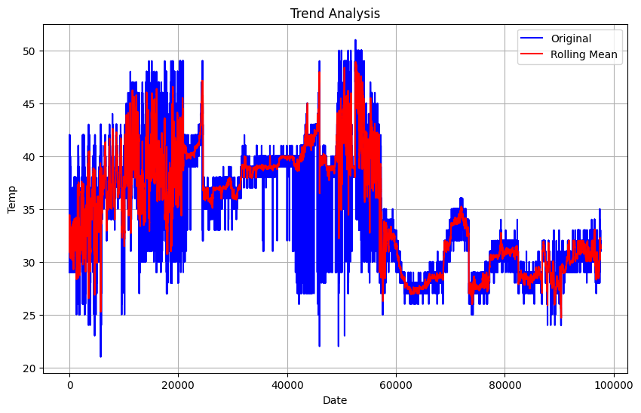
Warm Weather is on the Menu
The data shows that we are looking at a mostly warm climate for the area, but let’s take a deeper look at what you can expect before making your decision.
The average temperature throughout the year for the given area is approximately 35 degrees Celsius.
The most frequently occurring temperature in our data 39 degrees Celsius.
On average temperatures will vary between approximately 29 and 41 degrees Celsius.

Slide 5
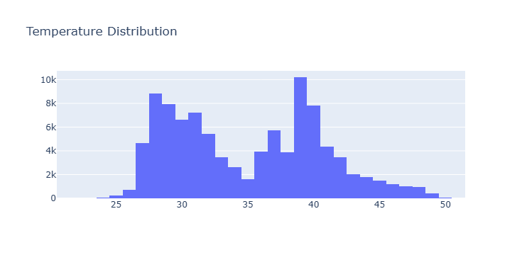
What about the cold and extreme weather?
25% of our data shows temperatures falling below 30 degrees celsius.
75% of the data shows temperatures being below 40 degrees Celsius.

Slide 6

Do you enjoy warm weather for a majority of your living experience?
This region is the one for you.

